Slide 1
تهیه و تنظیم : فاطمه مستاجر
مرداد 97

Slide 2
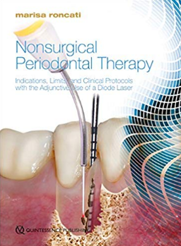
Nonsurgical Periodontal Therapy
Indications, Limits, and Clinical Protocols with the Adjunctive Use of a Diode Laser
Marisa roncati 2017
مرداد 97

Slide 3
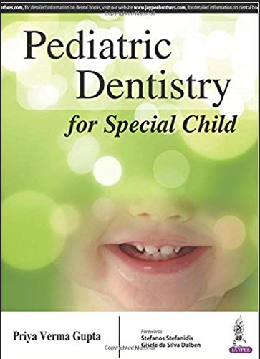
Pediatric Dentistry for Special Child
/ Priya Verma Gupta 2016
مرداد 97

Slide 4
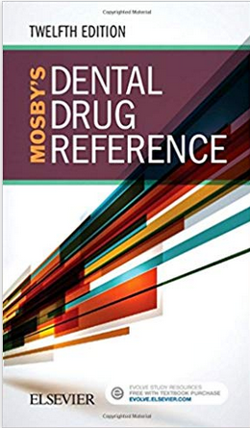
Mosby's Dental Drug Reference
/ Arthur H 2018
مرداد 97

Slide 5
Sturdevant's Art and Science of Operative Dentistry/ Andre V. Ritter 2019
مرداد 97

Slide 6
Digital Implantology / Giuseppe Luongo 2018
مرداد 97

Slide 7
Differential Diagnoses in Surgical Pathology: Head and Neck / William H. Westra 2017
مرداد 97

Slide 8
Ten Cate's Oral Histology: Development, Structure, and Function/ Antonio Nanci 2018
مرداد 97

Slide 9
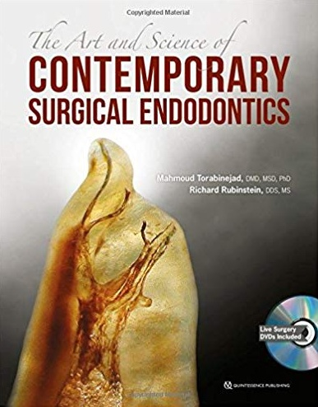
The Art and Science of Contemporary Surgical Endodontics / Mahmoud Torabinejad 2017
مرداد 97

Slide 10
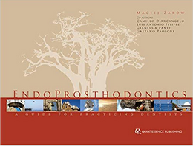
EndoProsthodontics: A Guide for Practicing Dentists 1st Edition / Maciej Zarow 2017
مرداد 97

Slide 11
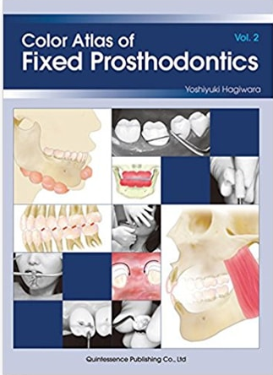
Color Atlas of Fixed Prosthodontics / Hagiwara, Yoshiyuki
2016
مرداد 97

Slide 12
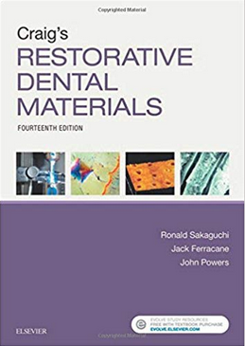
Craig's Restorative Dental Materials /
Ronald L. Sakaguchi 2019
مرداد 97

Slide 13
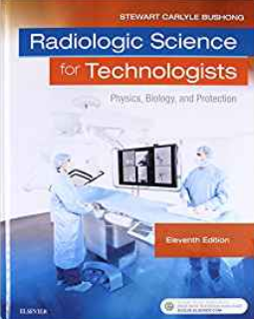
Radiologic Science for Technologists: Physics, Biology, and Protection / Stewart C. Bushong 2017
مرداد 97

Slide 14
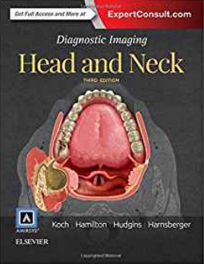
Diagnostic Imaging: Head and Neck
/ Bernadette L Koch 2017
مرداد 97

Slide 15
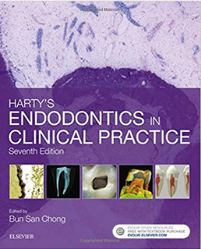
Harty's Endodontics in Clinical Practice
/ Bun San Chong 2017
مرداد 97

Slide 16
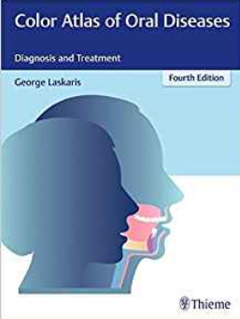
Color Atlas of Oral Diseases: Diagnosis and Treatment / George Laskaris 2017
مرداد 97

Slide 17
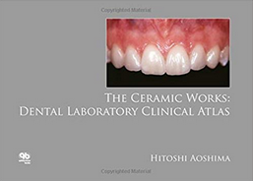
The Ceramic Works: Dental Laboratory Clinical Atlas / Hitoshi Aoshima 2016
مرداد 97

Slide 18
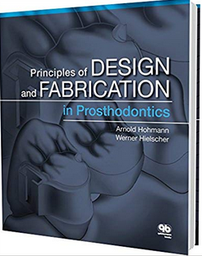
Principles and Design and Fabrication in Prosthodontics
/ Arnold Hohman 2016
مرداد 97

Slide 19
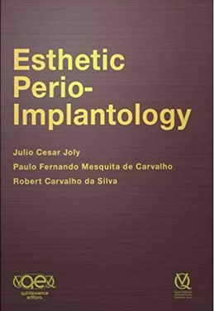
Esthetic Perio-Implantology 1st Edition/
Julio Cesar Joly 2017
مرداد 97

Slide 20
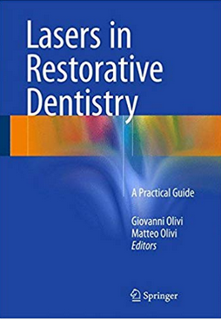
Lasers in Restorative Dentistry: A Practical Guide
/ Giovanni Olivi 2015
مرداد 97

Slide 21
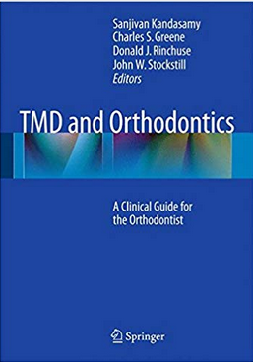
TMD and Orthodontics: A clinical guide for the orthodontist
/ Sanjivan Kandasamy 2015
مرداد 97

Slide 22
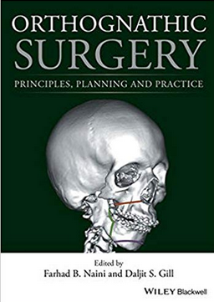
Orthognathic Surgery: Principles, Planning and Practice / Farhad B. Naini 2017
مرداد 97

Slide 23
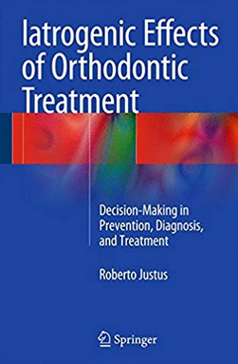
Iatrogenic Effects of Orthodontic Treatment: Decision-Making in Prevention, Diagnosis, and Treatment
/ Roberto Justus 2015
مرداد 97

Slide 24
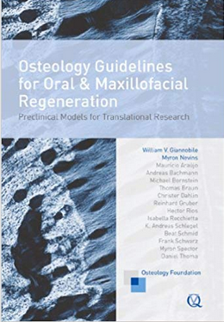
Osteology Guidelines for Oral and Maxillofacial Regeneration: Preclinical Models for Translational Research
/ William V. Giannobile 2016
مرداد 97

Slide 25
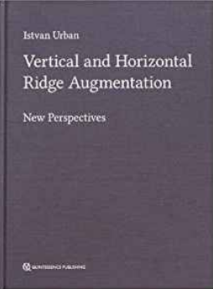
Vertical and Horizontal Ridge Augmentation: New Perspectives / István Urbán 2017
مرداد 97

Slide 26
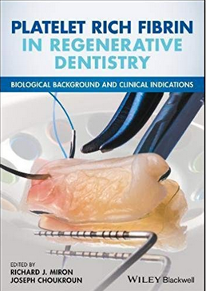
Platelet Rich Fibrin in Regenerative Dentistry: Biological Background and Clinical Indications / Richard J. Miron
2017
مرداد 97

Slide 27
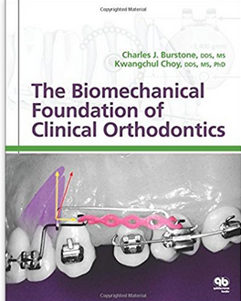
The Biomechanical Foundation of Clinical Orthodontics 1st Edition / Charles J. Burstone 2015
مرداد 97

Slide 28
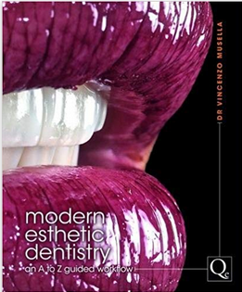
Modern Esthetic Dentistry: An A to Z Guided Workflow
/ Vincenzo Musella 2017
مرداد 97

Slide 29
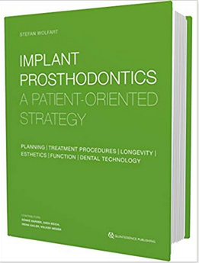
Implant Prosthodontics: A Patient-Oriented Strategy
/ Stefan Wolfart 2016
مرداد 97

Slide 30
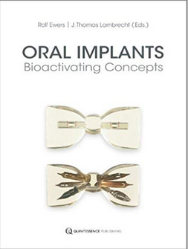
Oral Implants: Bioactivating Concepts
/ Rolf Ewers 2013
مرداد 97

Slide 31
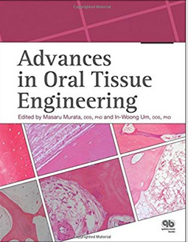
Advances in Oral Tissue Engineering / Masaru Murata 2014
مرداد 97

Slide 32
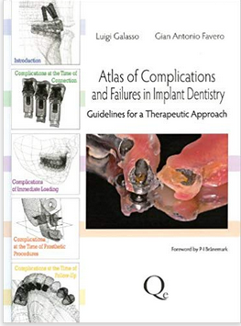
Atlas of Complications and Failures in Implant Dentistry: Guidelines for a Therapeutic Approach / Luigi Galasso 2013
مرداد 97

Slide 33
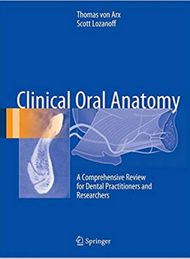
Clinical Oral Anatomy: A Comprehensive Review for Dental Practitioners and Researchers / Thomas von Arx 2017
مرداد 97

Slide 34
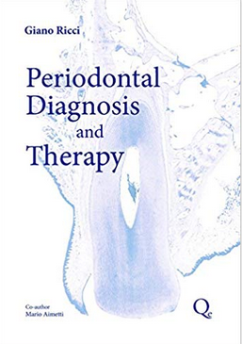
Periodontal Diagnosis and Therapy 1st Edition
/ Giano Ricci 2014
مرداد 97

Slide 35
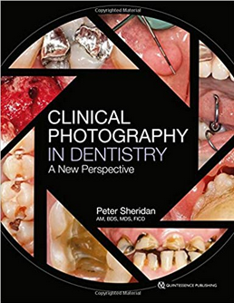
Clinical Photography in Dentistry: A New Perspective
/ Peter Sheridan 2017
مرداد 97

Slide 36
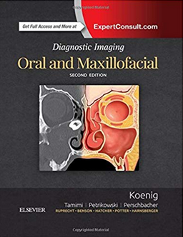
Diagnostic Imaging: Oral and Maxillofacial
/ Lisa J. Koenig 2017
مرداد 97

Slide 37
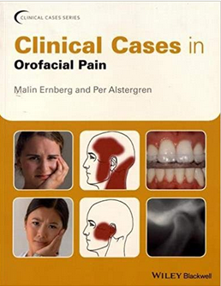
Clinical Cases in Orofacial Pain (Clinical Cases (Dentistry)/ Malin Ernberg 2017
مرداد 97

Slide 38
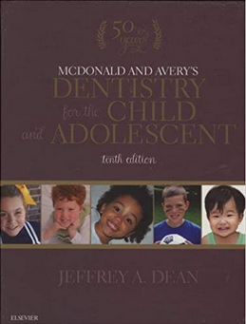
McDonald and Avery's Dentistry for the Child and Adolescent/ Jeffrey A. Dean 2016
مرداد 97

Slide 39
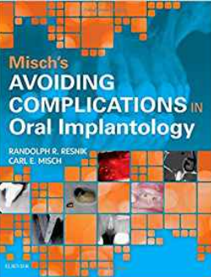
Misch's Avoiding Complications in Oral Implantology
/ Carl E. Misch 2018
مرداد 97

Slide 40
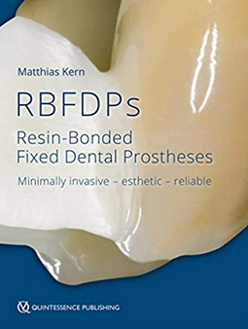
RBFDPs: Resin-Bonded Fixed Dental Prostheses
/ Matthias Kern 2018
مرداد 97

Slide 41
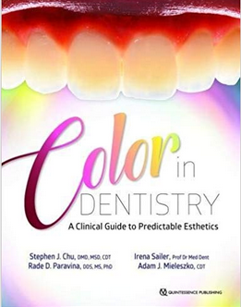
Color in Dentistry: A Clinical Guide to Predictable Esthetics
/ Stephen J. Chu 2017
مرداد 97

Slide 42
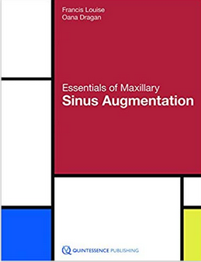
Essentials of Maxillary Sinus Augmentation
/ Francis Louise 2018
مرداد 97

Slide 43
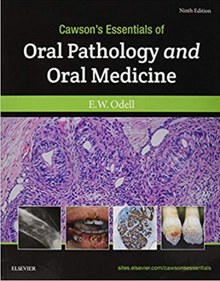
Cawson's Essentials of Oral Pathology and Oral Medicine / Edward W Odell FDSRCS 2017
مرداد 97

Slide 44
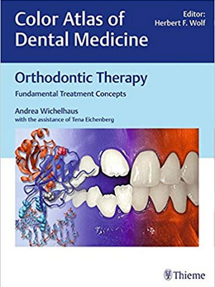
Orthodontic Therapy: Fundamental Treatment Concepts (Color Atlas of Dental Medicine) / Andrea Wichelhau 2017
مرداد 97

Slide 45
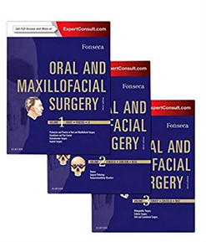
Oral and Maxillofacial Surgery/ Raymond J. Fonseca
2018
مرداد 97

Slide 46
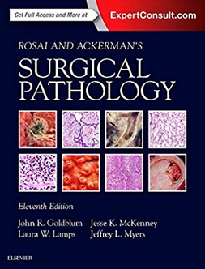
Rosai and Ackerman's Surgical Pathology
/ John R. Goldblum 2018
مرداد 97

Slide 47
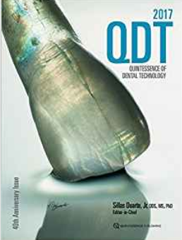
Quintessence of Dental Technology / Sillas Duarte
2017
مرداد 97

Slide 48
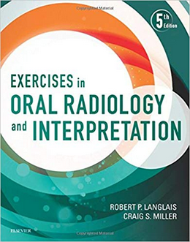
Exercises in Oral Radiology and Interpretation
/ Robert P. Langlais 2016
مرداد 97

Slide 49
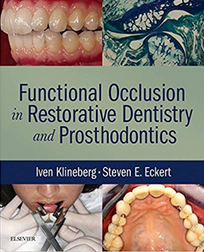
Functional Occlusion in Restorative Dentistry and Prosthodontics / Iven Klineberg 2016
مرداد 97

Slide 50
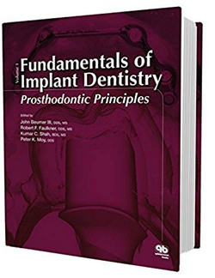
Fundamentals of Implant Dentistry: Prosthodontic Principles/ John Beumer 2015
مرداد 97

Slide 51
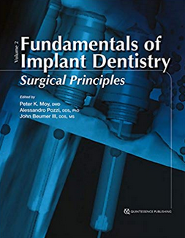
Fundamentals of Implant Dentistry: Surgical Principles / Peter K. Moy 2015
مرداد 97

Slide 52
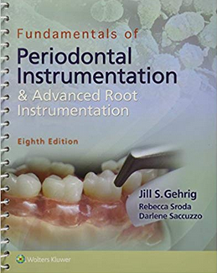
Fundamentals of Periodontal Instrumentation and Advanced Root Instrumentation Eighth Edition
/ Jill Gehrig 2017
مرداد 97

Slide 53
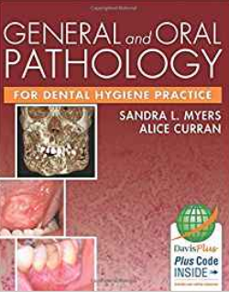
General and Oral Pathology for Dental Hygiene Practice / Sandra L. Myers 2014
مرداد 97

Slide 54
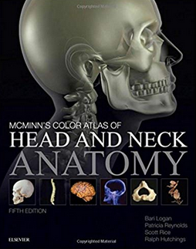
McMinn's Color Atlas of Head and Neck Anatomy
/ Bari M. Logan 2017
مرداد 97

Slide 55
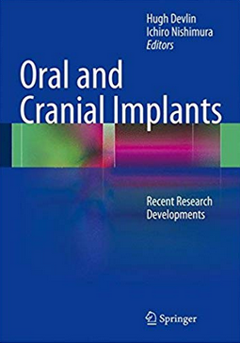
Oral and Cranial Implants: Recent Research Developments / Hugh Devlin 2013
مرداد 97

Slide 56
Orthodontic and Surgical Management of Impacted Teeth / Vincent G. Kokich 2014
مرداد 97

Slide 57
Oral Pathology: Clinical Pathologic Correlations
/ Joseph A. Regezi 2017
مرداد 97

Slide 58
Orthodontics in the Vertical Dimension: A Case-Based Review /Thomas E. Southard 2015
مرداد 97

Slide 59
Orthodontically Driven Corticotomy: Tissue Engineering to Enhance Orthodontic and Multidisciplinary Treatment
/Federico Brugnami 2015
مرداد 97

Slide 60
Patient Assessment Tutorials: A Step-By-Step Guide for the Dental Hygienist / Jill Gehrig 2018
مرداد 97

Slide 61
Pediatric Dentistry: A Clinical Approach
/ Goran Koch 2017
مرداد 97

Slide 62
Paediatric Dentistry at a Glance / Monty Duggal
2013
مرداد 97

Slide 63
Pediatric Laser Dentistry: A User's Guide
/Giovanni Olivi 2011
مرداد 97

Slide 64
Periodontology for the Dental Hygienist
/Dorothy A. Perry 2014
مرداد 97

Slide 65
Pitt Ford's Problem-Based Learning in Endodontology / Shanon Patel 2011
مرداد 97

Slide 66
Soft-Tissue Lasers in Dental Hygiene / Jessica Blayden
2013
مرداد 97

Slide 67
Stem Cell Biology and Tissue Engineering in Dental Sciences / Ajaykumar Vishwakarma 2015
مرداد 97

Slide 68
Textbook of Geriatric Dentistry /Poul Holm-Pederse
2015
مرداد 97

Slide 69
Textbook of Preclinical Conservative Dentistry / Nisha Garg 2011
مرداد 97

Slide 70
The Biomechanical Foundation of Clinical Orthodontics / Charles J. Burstone 2015
مرداد 97

Slide 71
Woelfels Dental Anatomy Ninth Edition
/ Rickne C. Scheid 2017
مرداد 97

Slide 72
Alveolar Distraction Osteogenesis: ArchWise Appliance and Technique /Nejat Erverdi 2015
مرداد 97

Slide 73
Atlas of Current Oral Laser Surgery/ S. Namour
2011
مرداد 97

Slide 74
Behavior Management in Dentistry for Children / Gerald Z. Wright 2014
مرداد 97

Slide 75
Cementation in Dental Implantology
/ Wadhwani, Chandur 2015
مرداد 97

Slide 76
Churchill's Pocketbooks Clinical Dentistry
/ Crispian Scully 2016
مرداد 97

Slide 77
Clinical Cases in Implant Dentistry
/ Nadeem Karimbux 2017
مرداد 97

Slide 78
Clinical Practice of the Dental Hygienist
/ Esther M. Wilkins 2017
مرداد 97

Slide 79
Clinical Problem Solving in Dentistry: Orthodontics and Paediatric Dentistry / Declan Millett 2017
مرداد 97

Slide 80
Clinical Textbook of Dental Hygiene and Therapy / Suzanne Noble 2012
مرداد 97

Slide 81
Communication Skills for Dental Health Care Providers 1st Edition / Lance Brendan Young 2015
مرداد 97

Slide 82
Cone Beam Computed Tomography in Endodontics
/ Shannon Patel 2016
مرداد 97

Slide 83
Contemporary Esthetic Dentistry
/ George A. Freedman 2012
مرداد 97

Slide 84
Dental Assisting Instrument Guide, Spiral bound Version /Donna J. Phinney 2015
مرداد 97

Slide 85
Dental Implant Complications: Etiology, Prevention, and Treatment / Stuart J. Froum 2016
مرداد 97

Slide 86
Dental Materials: Clinical Applications for Dental Assistants and Dental Hygienists / W. Stephan Eakle 2016
مرداد 97

Slide 87
diFiore's Atlas of Histology: with Functional Correlations / Victor P. Eroschenko 2013
مرداد 97

Slide 88
Essentials of Dental Assisting - Text and Workbook Package / Debbie S. Robinson 2017
مرداد 97

Slide 89
Esthetic Implant Restoration in the Edentulous Maxilla/ Karim Dada 2014
مرداد 97

Slide 90
Evidence-Based Decision Making in Dentistry
/Rosen, Eyal 2017
مرداد 97

Slide 91
Implants in the Esthetic Zone: A Step-by-Step Treatment Strategy / Ueli Grunder 2016
مرداد 97

Slide 92
Sinus Floor Elevation: Avoiding Pitfalls Using Cone-beam CT / Yasuhiro Nosaka 2014
مرداد 97

Slide 93
Netter's Head and Neck Anatomy for Dentistry/ Neil S. Norton 2017
مرداد 97

Slide 94
Evidence-Based Periodontal and Peri-Implant Plastic Surgery: A Clinical Roadmap from Function to Aesthetics 2015th Edition
by Leandro Chambrone 2015
مرداد 97

Slide 95
Nanotechnology in Endodontics: Current and Potential Clinical Applications / Anil Kishen 2015
مرداد 97

