Slide 1
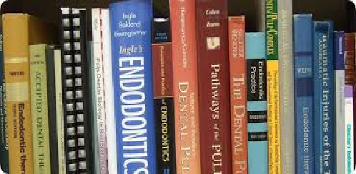
کتابهای خریداری شده از نمایشگاه بین المللی تهران
اردیبهشت ماه 98

Slide 2
Postgraduate Notes in Orthodontics
2015
WU / 400
تیر ماه 98

Slide 3
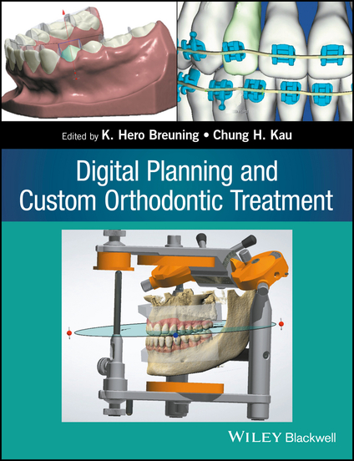
Digital Planning and Custom Orthodontic Treatment 2017
WU / 400
تیر ماه 98

Slide 4
A New Era in Diagnosis and 3D Imaging in Endodontics
Treatment/ Fayad, Mohamed 2016
WU / 230
تیر ماه 98

Slide 5
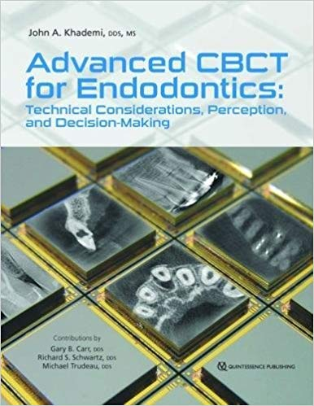
Advanced CBCT for Endodontics: Technical Considerations, Perception, and / John A. Khademi 2017 Decision-Making
WU / 230
تیر ماه 98

Slide 6
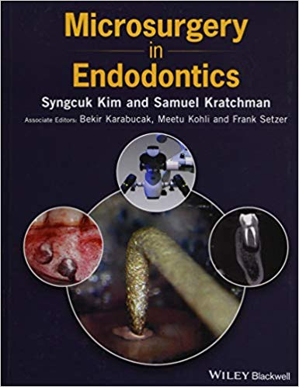
Microsurgery in Endodontics /Syngcuk Kim 2018
WU / 230
تیر ماه 98
تیر ماه 98

Slide 7
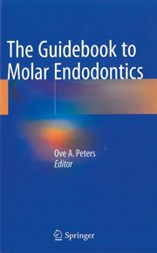
2017 Ove A. Peters / The Guidebook to Molar Endodontics
WU / 230
تیر ماه 98

Slide 8
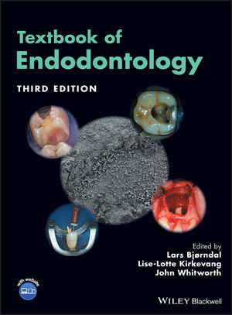
2010 lars bjorndal/ Textbook of Endodontology,
WU / 230
تیر ماه 98

Slide 9
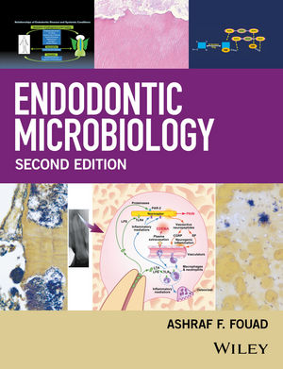
Ashraf F. Fouad 2017َEndodontic Microbiology /
WU / 230
تیر ماه 98

Slide 10
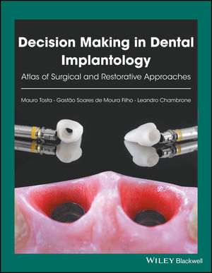
Decision Making in Dental Implantology: Atlas of Surgical Approaches and Restorative /Mauro Tosta 2018
WU / 640
تیر ماه 98

Slide 11
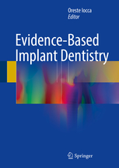
Iocca, Oreste/Evidence-Based Implant Dentistry
2016
WU / 640
تیر ماه 98

Slide 12
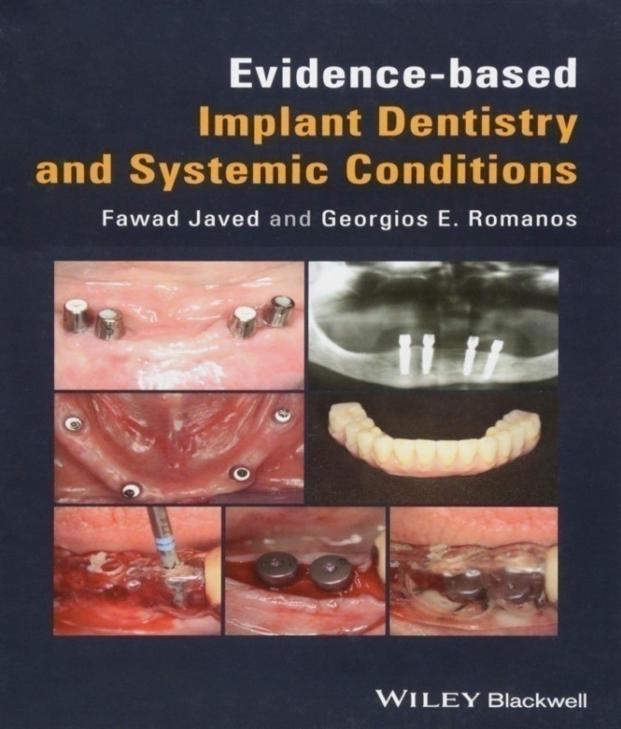
Avidence-baced Implant Dentistry and systemic Condition
Fawad Javed 2018
WU / 640
تیر ماه 98

Slide 13
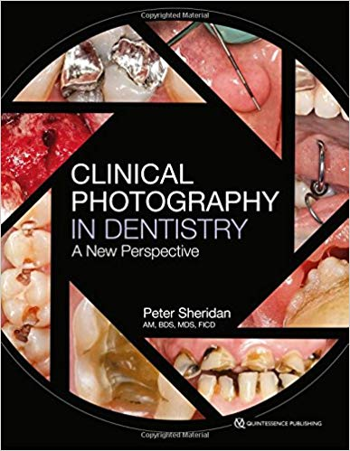
Clinical Photography in Dentistry: A New Perspective
Peter Sheridan 2016
WN / 230
تیر ماه 98

Slide 14
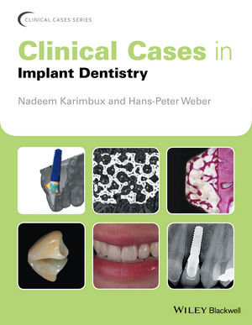
Nadeem Karimbux / Clinical Cases in Implant Dentistry
2017
WU / 640
تیر ماه 98

Slide 15
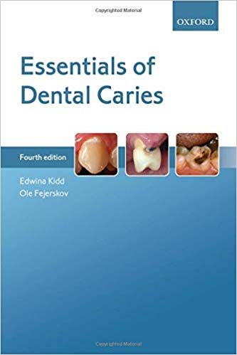
Essentials of Dental Caries / Edwina Kidd
2016
WN / 270
تیر ماه 98

Slide 16
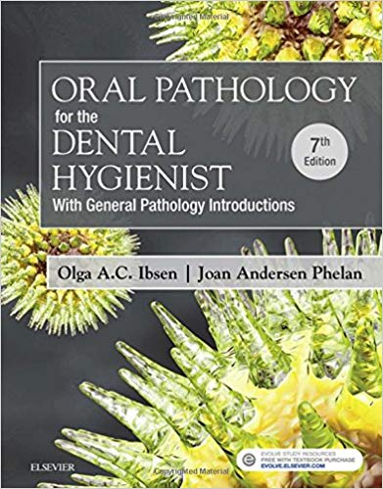
Olga A.C. 2018/ Oral Pathology for the Dental Hygienist
WU / 140
تیر ماه 98

Slide 17
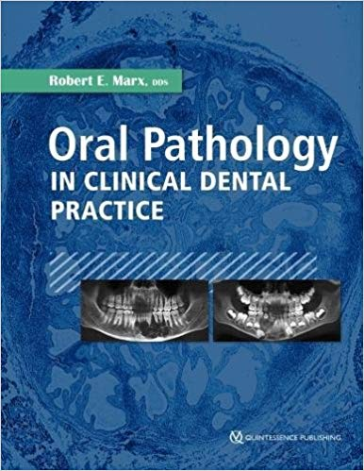
Robert E. Marx/ Oral Pathology in Clinical Dental Practice
2017
WU / 140
تیر ماه 98

Slide 18
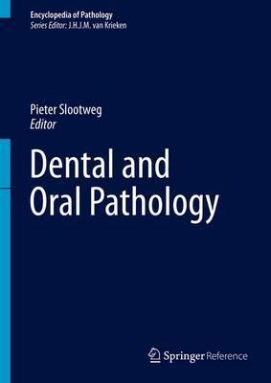
Pieter J. Slootweg 2016/ Dental and Oral Pathology
WU / 140
تیر ماه 98

Slide 19
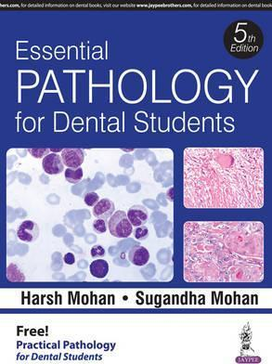
Harsh Mohan 2016 / Essential Pathology for Dental Students
WU / 140
تیر ماه 98

Slide 20
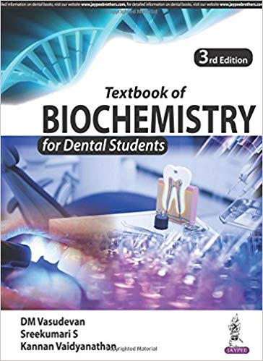
Textbook of Biochemistry for Dental Students
M Vasudevan 2018
QU / 4
تیر ماه 98

Slide 21
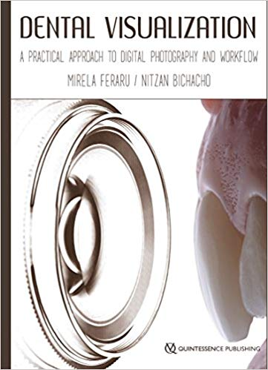
Dental Visualization: A Practical Approach to Digital Photography 2018 /and Workflow
WN / 230
تیر ماه 98

Slide 22
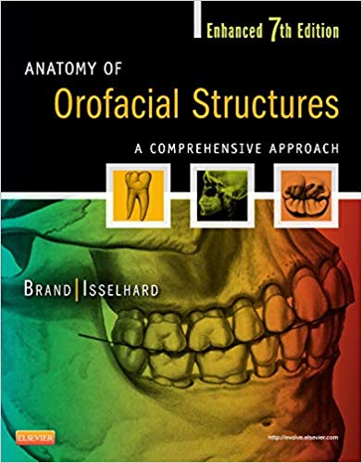
Richard W Brand/Anatomy of Orofacial Structures
2014
WU / 101
تیر ماه 98
تیر ماه 98

Slide 23
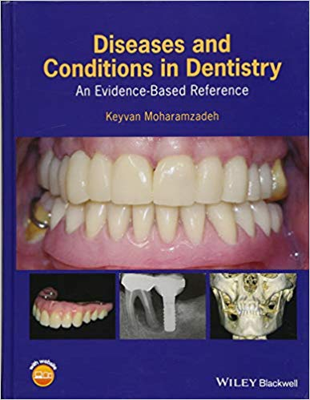
Diseases and Conditions in Dentistry: An Evidence- Keyvan Moharamzadeh 2018 /Based Reference
WU / 140
تیر ماه 98

Slide 24
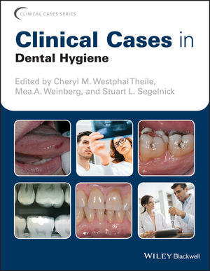
Clinical Cases in Dental Hygiene/ Cheryl M 2018
WU / 113
تیر ماه 98

Slide 25
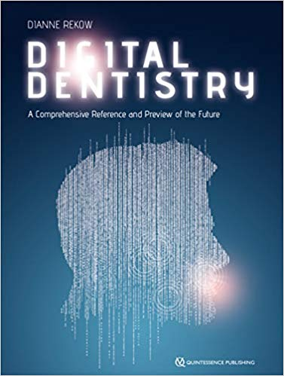
Digital Dentistry: A Comprehensive Reference and Preview Dianne Rekow 2018/of the Future
WU / 26.5
تیر ماه 98

Slide 26
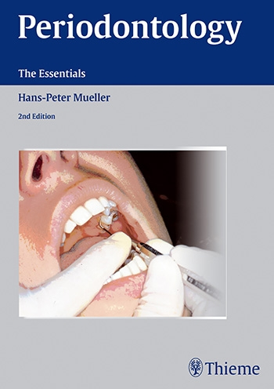
Periodontology The Essentials
2016
WU / 240
تیر ماه 98

Slide 27
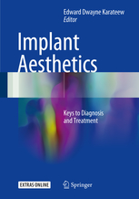
Keys to Diagnosis and Treatment Implant Aesthetics
2017 Karateew, Edward Dwayne
WU / 640
تیر ماه 98

Slide 28
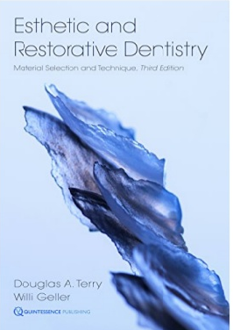
Esthetic and Restorative Dentistry: Material Selection Douglas A. 2018/ and Technique
WU / 17
تیر ماه 98

Slide 29
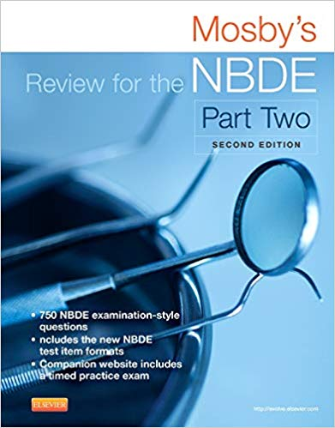
Mosby's Review for the NBDE Part II 2015
WU / 18
تیر ماه 98

Slide 30
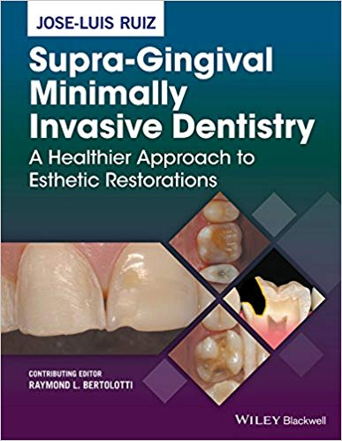
Supra-Gingival Minimally Invasive Dentistry: A Healthier
Approach to Esthetic Restorations/
Jose-Luis Ruiz 2017
WU / 300
تیر ماه 98

Slide 31
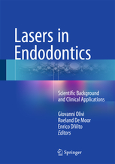
Lasers in Endodontics Scientific Background and Clinical / Applications/ Olivi, Giovanni 2016
تیر ماه 98

Slide 32
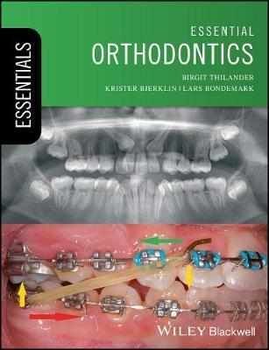
/ Birgit Thilander 2017 Essential Orthodontics
WU / 400
تیر ماه 98

Slide 33
Concepts and Clinical Application/ Extra-Coronal Restorations
Robert Wassell 2019
WU / 300
تیر ماه 98

Slide 34
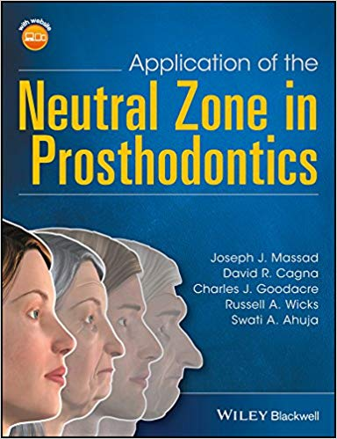
Application of the Neutral Zone in Prosthodontics
Joseph J. Massad 2017
WU / 530
تیر ماه 98

Slide 35
Root Caries: From Prevalence to Therapy/
Rocha de Olivera Carrilho 2017
WU / 270
تیر ماه 98

Slide 36
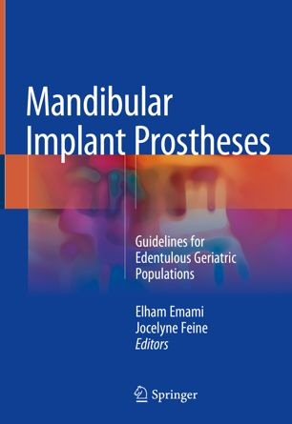
Guidelines for Mandibular Implant Prostheses
Edentulous Geriatric Populations /
2018 Elham Emami
تیر ماه 98

Slide 37
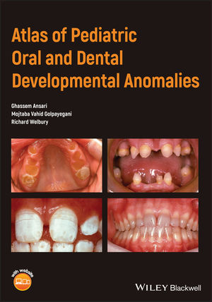
Atlas of Pediatric Oral and Dental Developmental Anomalies
Ghassem Ansari 2019
WU / 480
تیر ماه 98

Slide 38
Infection Control and Management of Hazardous Materials for the Dental Team,
2014 Chris H. Miller
تیر ماه 98

Slide 39
Essentials of Oral Histology and Embryology: A Clinical Approach
Daniel J. 2019
WU / 101
تیر ماه 98

